Slide 1

WEATHER OVER ISRAEL
DATA MINING AND MACHINE LEARNING
Liz Mizrahi and Tal Shlomo

Slide 2
—Can we predict the temperature without one of the parameterers of the weather?
Research Questions
—Which parameter is the least influential?

Slide 3
THE WEATHER IN ISRAEL
Weather refers to phenomena that occur in a relatively short time: an hour, a day, a week. For example: rain that falls on a certain day, a heat wave that lasts for several days.
Israel has a wide variety of climatic conditions, caused mainly by the country’s diverse topography. There are two distinct seasons: a cool, rainy winter (October–April) and a dry, hot summer (May–September).Average annual temperatures vary throughout Israel based on elevation and location, with the coastal areas adjacent to the Mediterranean Sea having milder temperatures—ranging from about 84 °F (29 °C) in August to about 61 °F (16 °C) in January—and higher rates of humidity than areas inland

Slide 4
THE PROCESS
01
02
03
Data Source
Data Cleaning
EDA & Visualization
Machine Learning
04

Slide 5
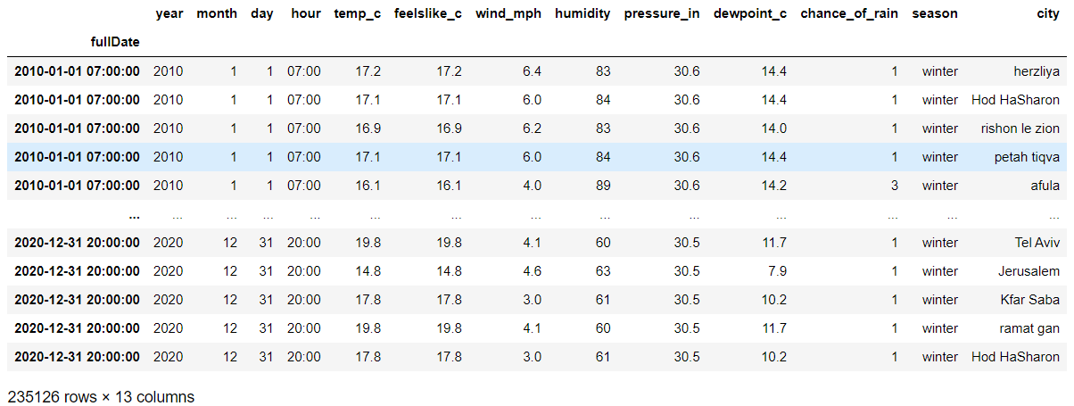

DATA SOURCE
 | API
www.weatherapi.com
We used a built-in API
Since retrieving all the data at once is forbidden, we wrote a script that collects 10 years of data (2010-2020), every day, 3 times in a day (7:00, 13:00, 20:00)
Finally, it concatenated into a dataframe

Slide 6
DATA CLEANING
Concatenation of all the information into one table while adjusting the columns into a uniform format.
Filter duplicates and empty values.
Outliners handling.

Slide 7
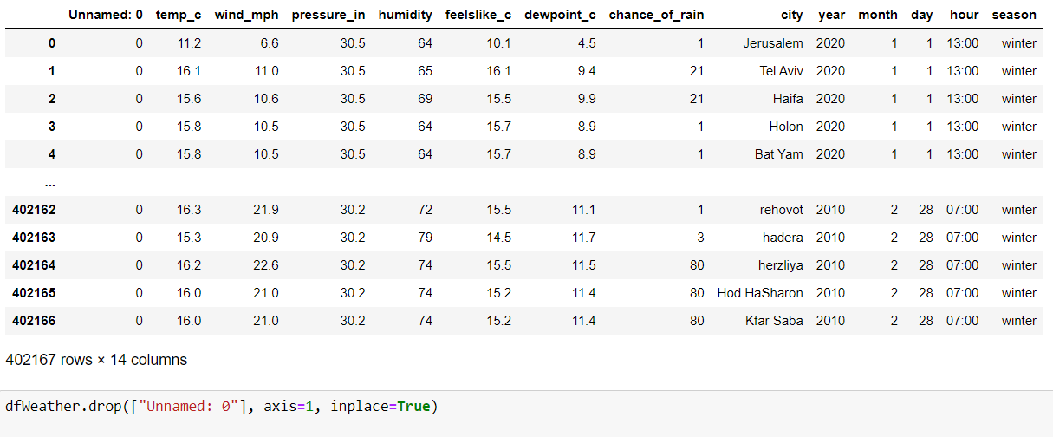
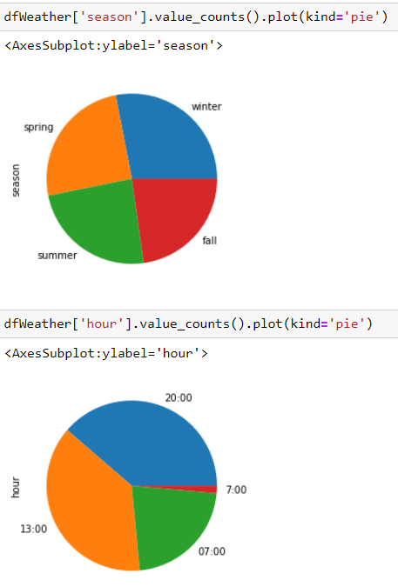
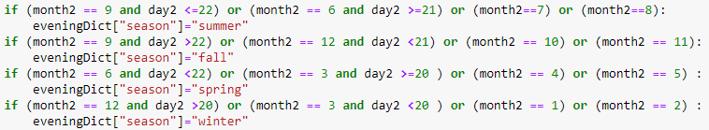
DATA CLEANING & ORGANIZATION
Fix the hour format from "HH:MM" to hour only
Classification according to season

Slide 8



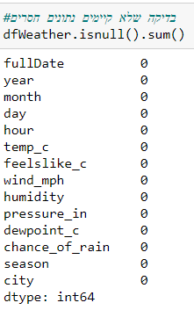
DATA CLEANING & ORGANIZING
Delete duplicate raws
Verify that there are no duplicates
Checking there are no NaN values

Slide 9
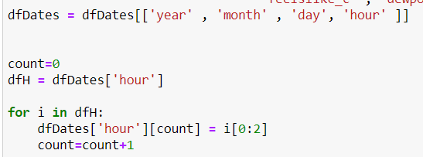



DATA CLEANING & ORGANIZING
Fix the hour format from "HH:MM" to hour only
Create in the df fulldate column with a format of datetime
Sort the dates
Set the fulldate column to be the index of the DF

Slide 10
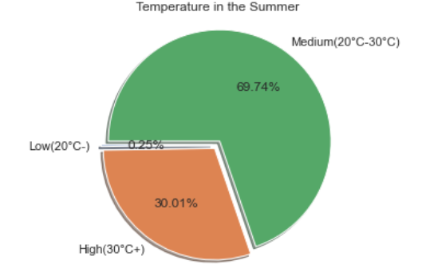
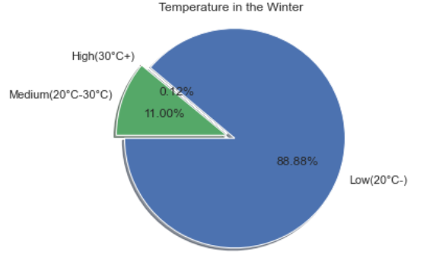
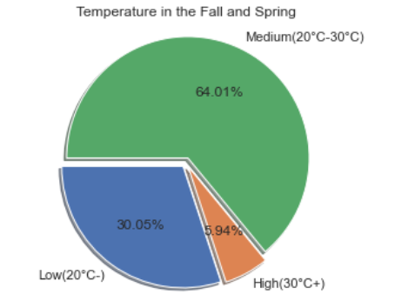
EDA & VISUALIZATION
Temperature distribution in the seasons
Summer
Winter
Spring & Fall

Slide 11
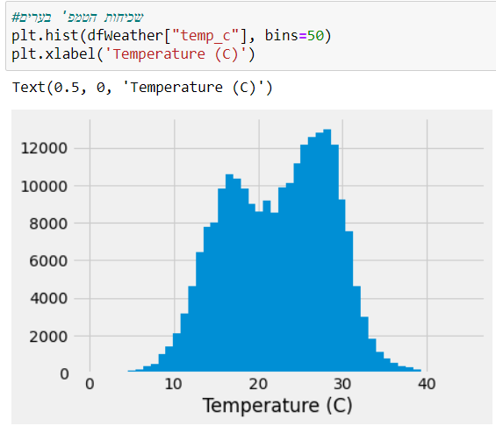
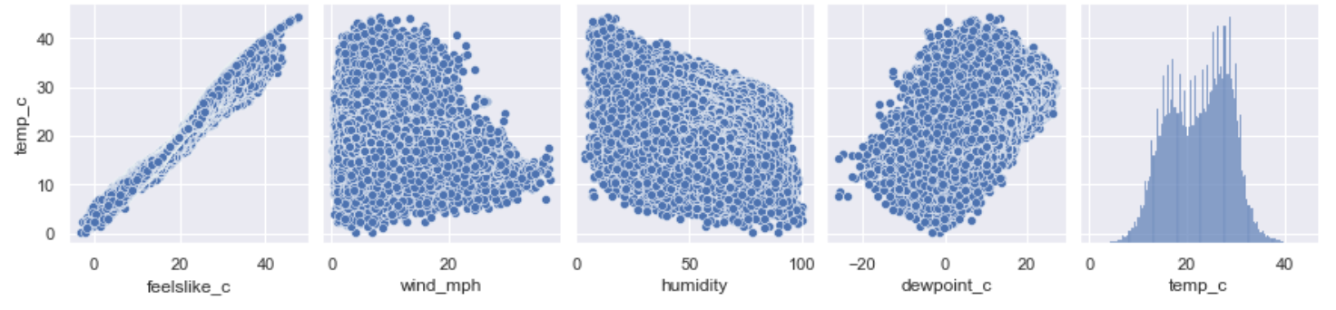
EDA & VISUALIZATION
Temperature Frequency in the cities

Slide 12
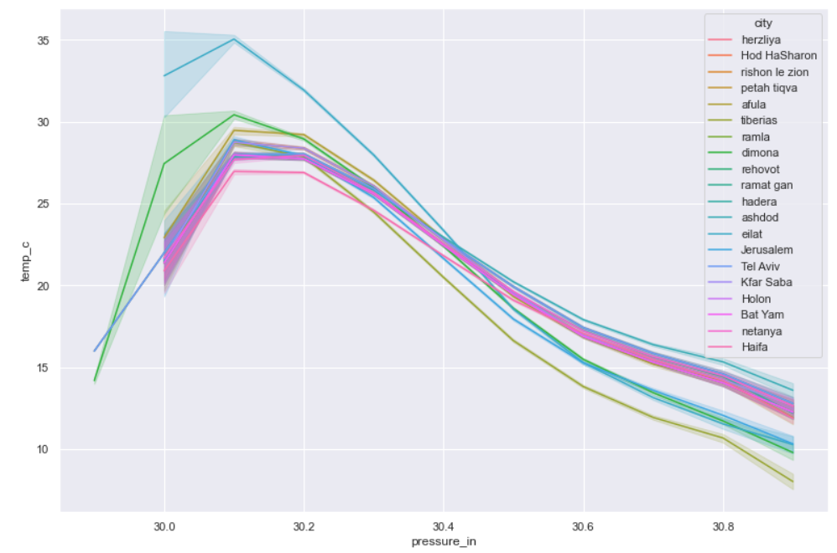
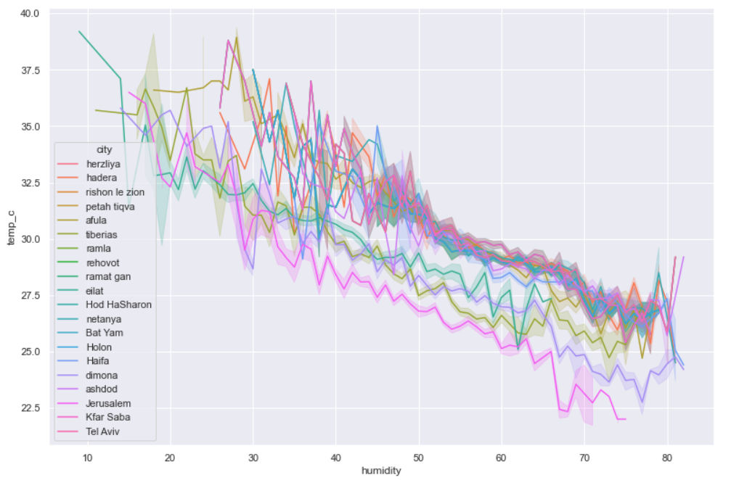
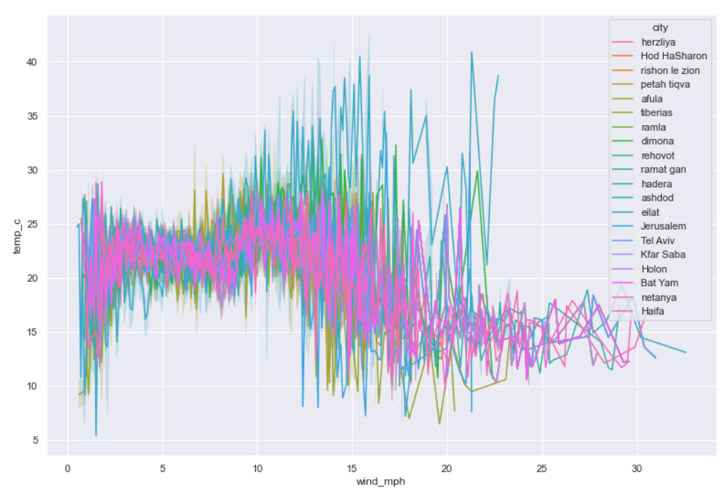
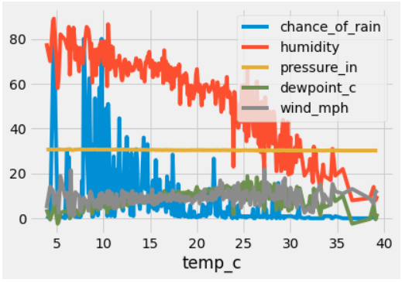
EDA & VISUALIZATION

Slide 13
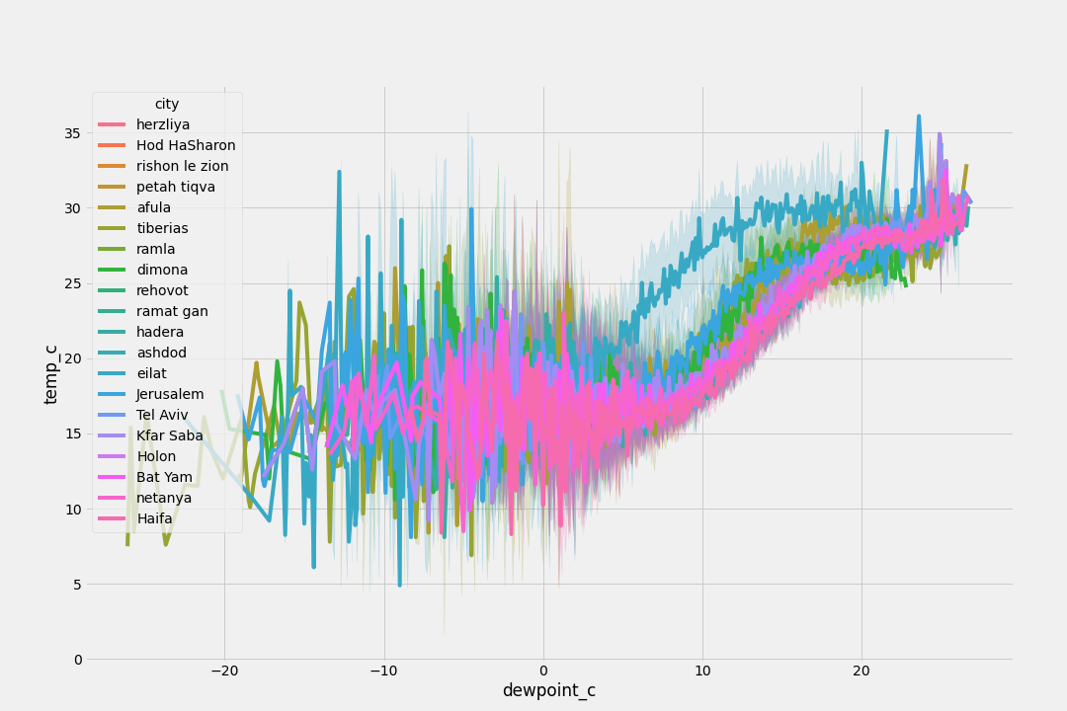
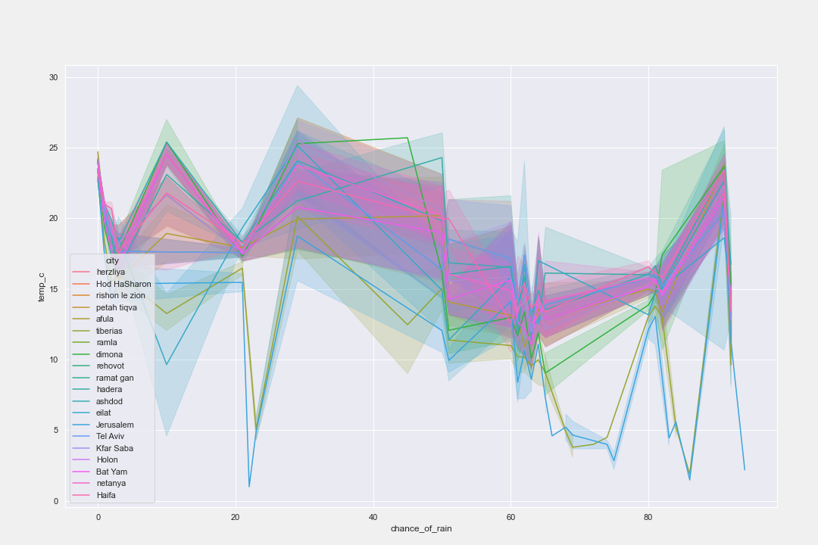
EDA & VISUALIZATION

Slide 14

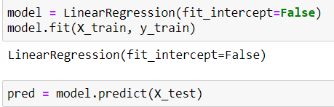
MACHINE LEARNING – LINEAR REGRESSION
Spliting the data for training and testing
Building the model

Slide 15
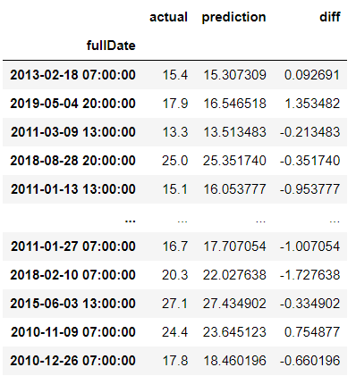
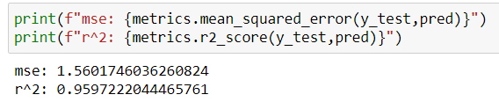
MACHINE LEARNING - PREDICTION
Our model is precise thanks to the amount of data that we had pulled
We can predict the weather certainly

Slide 16
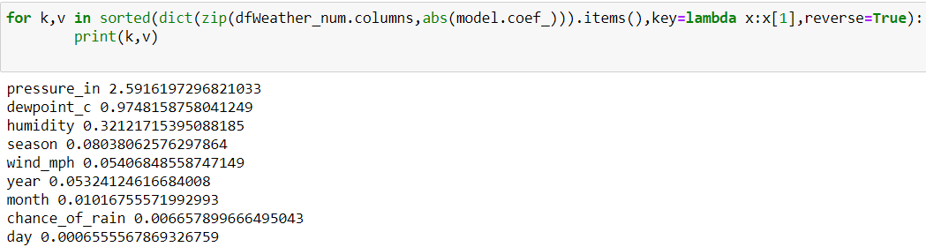
MACHINE LEARNING
Analysis of the most significant features that have impact on temperature

Slide 17
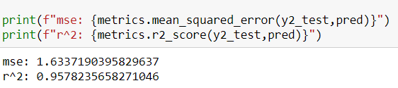
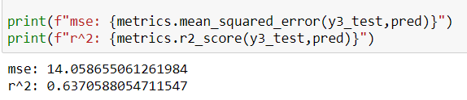
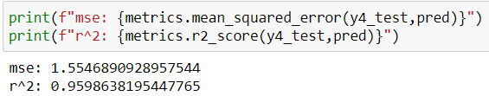
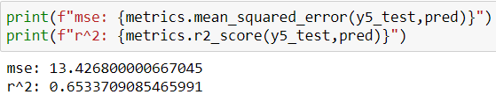
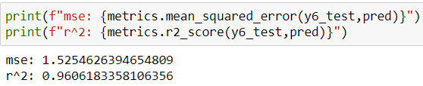
ML – LEAVE-ONE-OUT
CONCLUSION
PREDICTION WITHOUT ‘PRESSURE’
PREDICTION WITHOUT ‘HUMIDITY’
PREDICTION WITHOUT ‘WIND’
PREDICTION WITHOUT ‘DEWPOINT’
PREDICTION WITHOUT ‘CHANCE OF RAIN’
The temperature is mostly influenced by “Dewpoint” and “Humidity” parameters

Slide 18
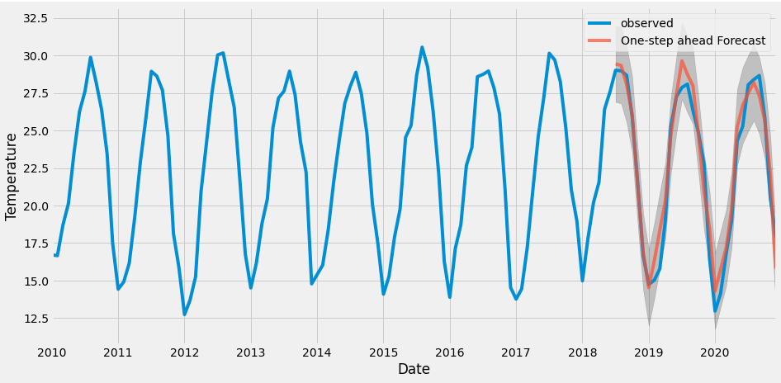
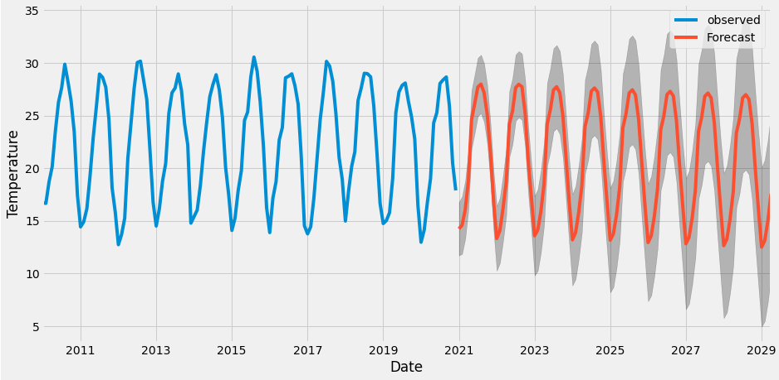
TIMESERIES - ARIMA

